Slide 1
Roofline: An Insightful Visual Performance Model for Floating-Point Programs and Multicore Architectures
CS 252A Paper Discussion
Jack Toubes

Slide 2
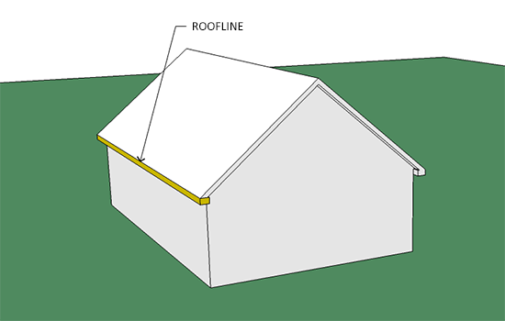

Slide 3
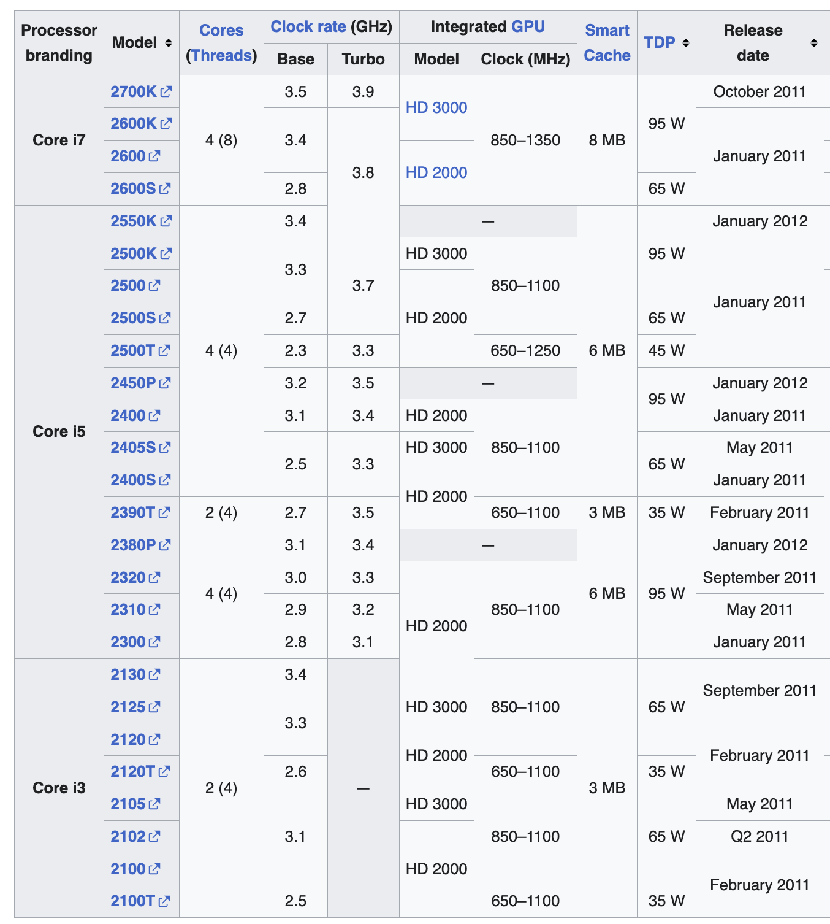
Context
It’s 2008, the multicore era is in full swing and architectures are on track to be more varied than ever before.
-> “An easy-to-understand model
that offers performance guidelines could be especially valuable.”

Slide 4
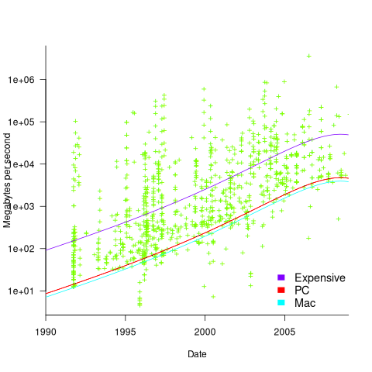
Context
It’s 2008, memory bandwidth isn’t scaling like it used to; Paper predicts memory bandwidth will be bottleneck for foreseeable future.
-> Model should prioritize the impact of memory bandwidth

Slide 5
The Goal
An architectural performance model that is easy to understand and which emphasizes the importance of memory bandwidth.

Slide 6
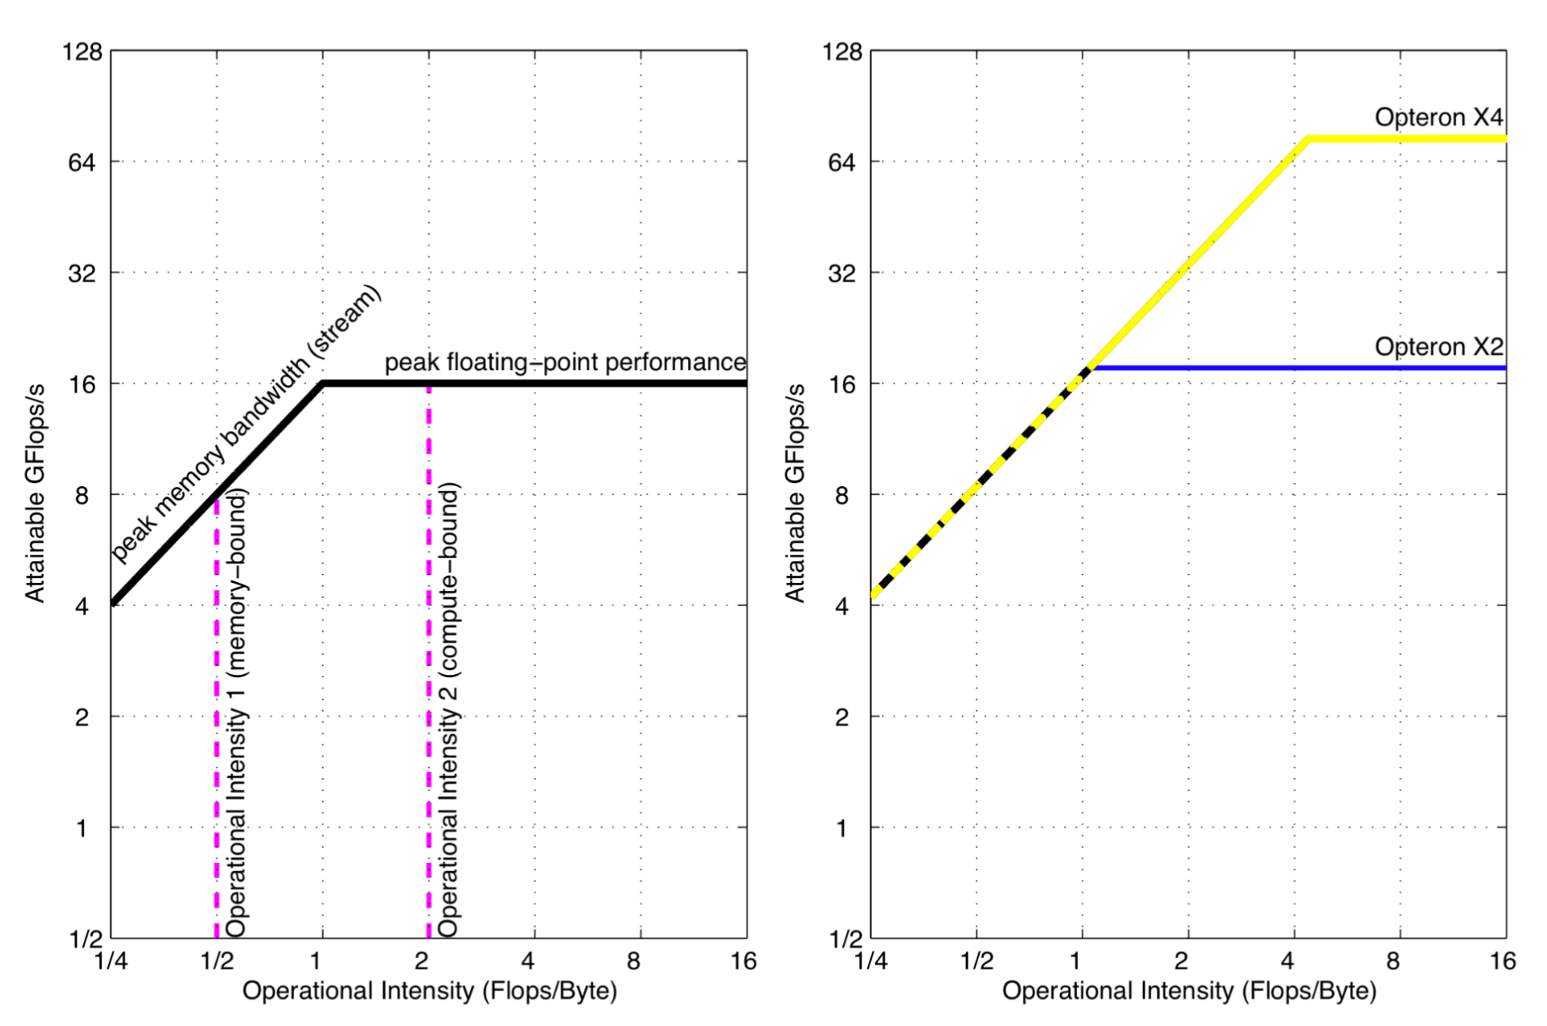
The Roofline Model
Start with performance on the Y axis (that’s what we want to model). GFlops / S
Put Flops per main memory access (of a given program) as the x axis. Flops / Byte
We get two lines to represent the architecture
Peak FPU utilization (no memory bottleneck)
Peak memory-performance (no FPU bottleneck)

Slide 7
The Roofline Model: Example
They put two processors with the same memory bandwidth but different core counts and microarches on the plot on the right.

Slide 8
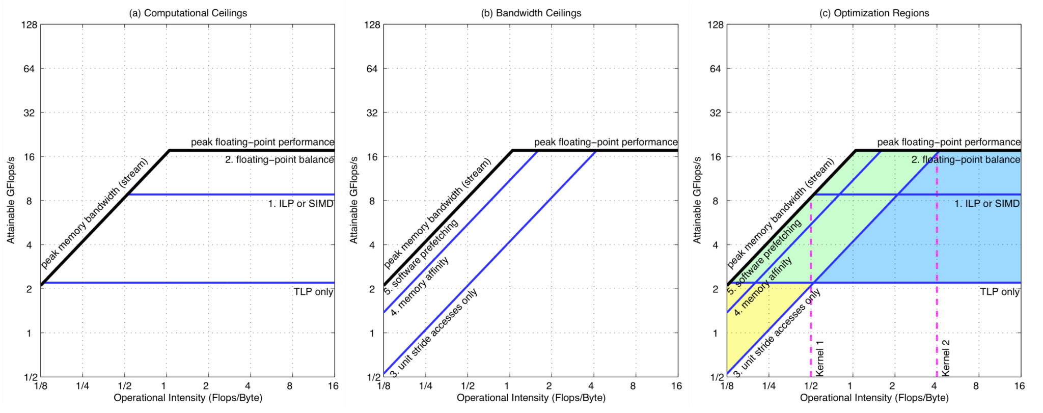
The Roofline Model: Ceilings
FP perf. optimizations horizontal lines
Memory perf. Optimizations parallel to memory bandwidth

Slide 9
The Roofline Model: Ceilings -> Rooms
These ceilings form rooms (they call them regions).
These different regions define locations where benchmarks can live based on the optimizations that they implement.
Potentially confusing… let’s discuss this later!

Slide 10
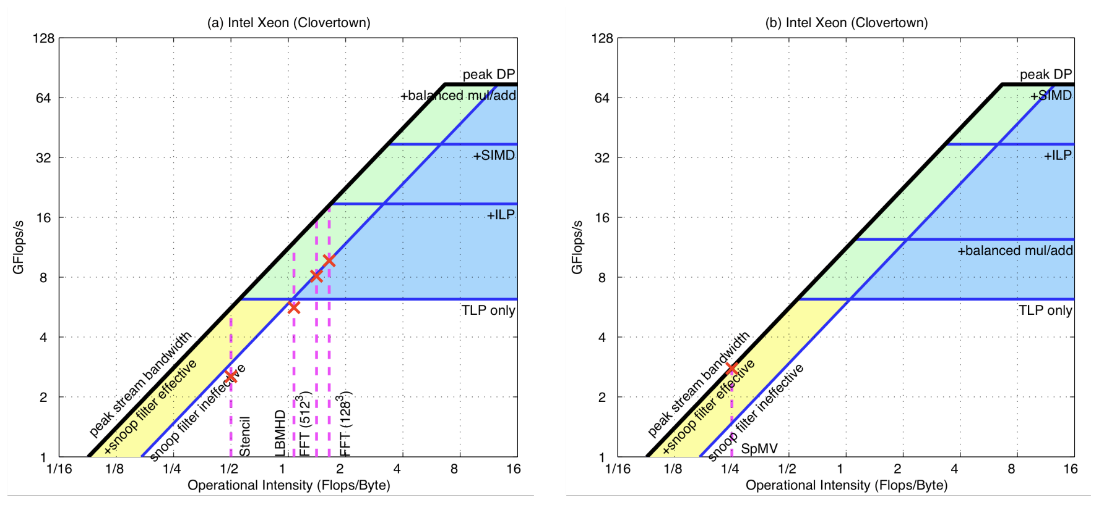
The Roofline Model: Example usage

Slide 11
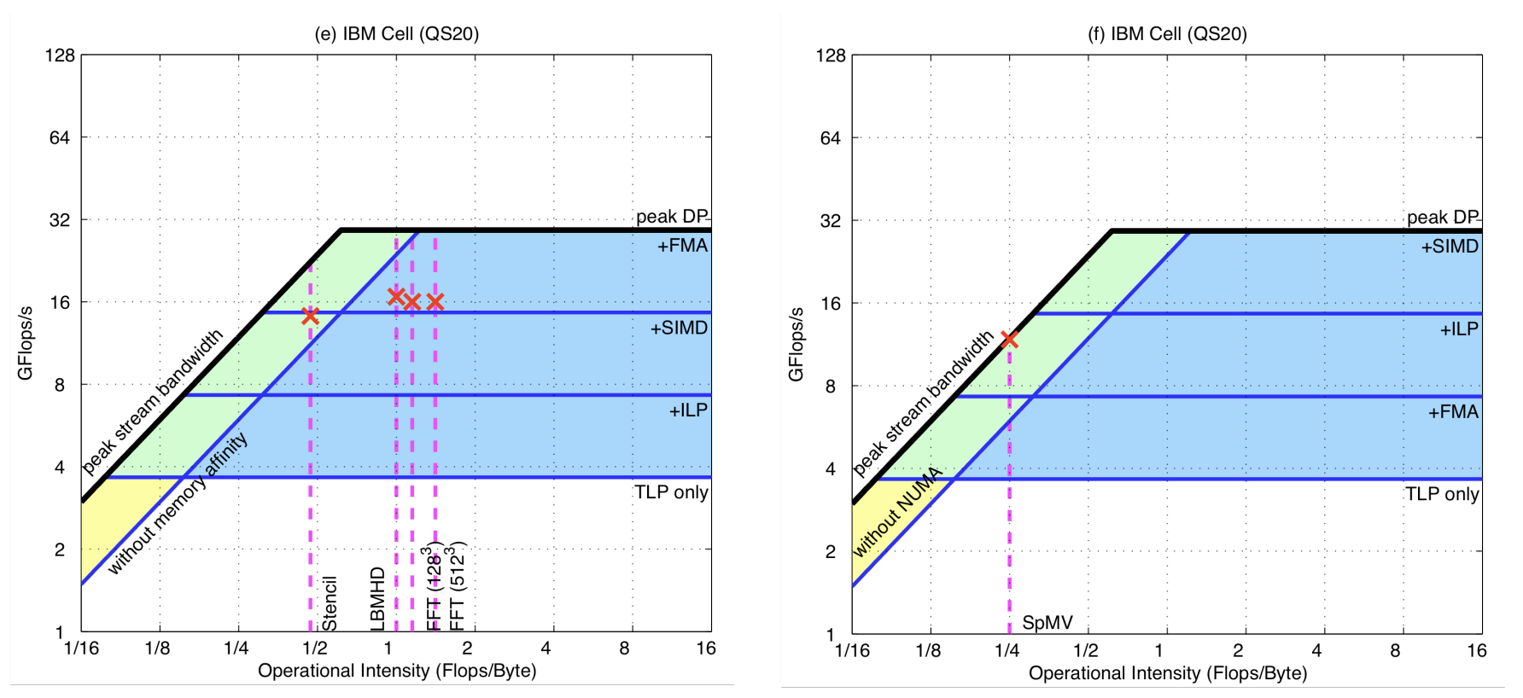
The Roofline Model: Example usage

Slide 12
The Roofline Model: Guidance for Architects
Low ridge point == easy to program
Compiling for SIMD is hard
Mature compilers are very important for leveraging uArch optimizations.

Slide 13
Discussion: Arbitrary placement of ceilings?
“We rank the ceilings from bottom to top: those most likely to be realized by a compiler or with little effort by a programmer are at the bottom and those that are difficult to be implemented by a programmer or inherently lacking in a kernel are at the top.”

Slide 14
Discussion: Accounting for Cache?
“The definition of operational intensity in this paper does indeed factor in caches: memory accesses are measured between the caches and memory, not between the processor and caches.”

Slide 15
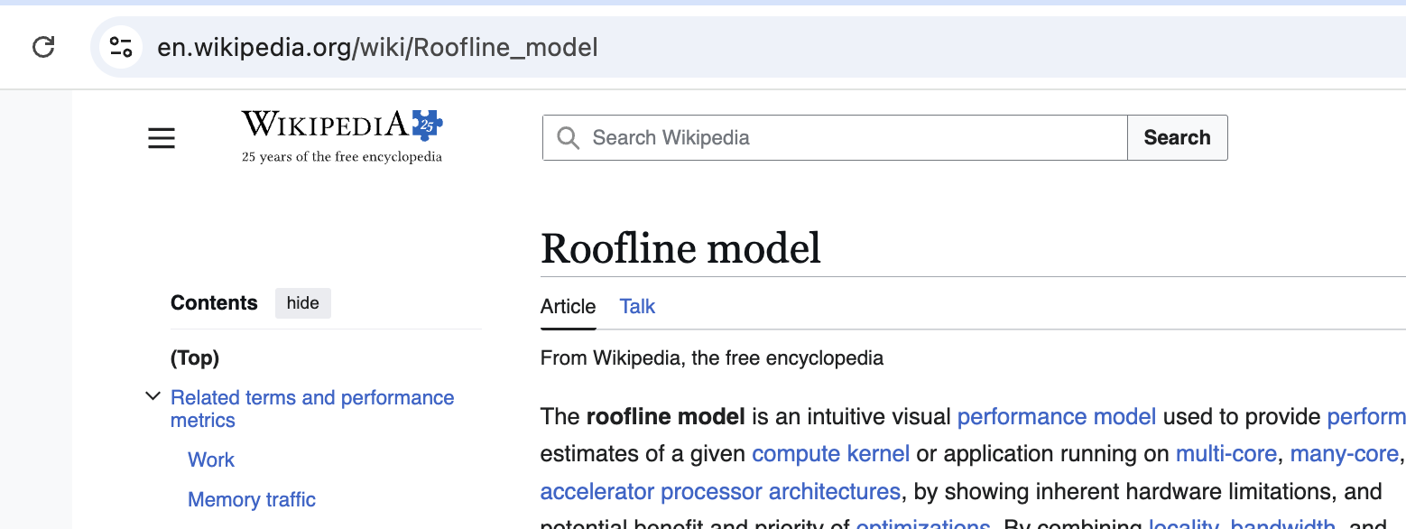
Discussion: Test of time?

Slide 16
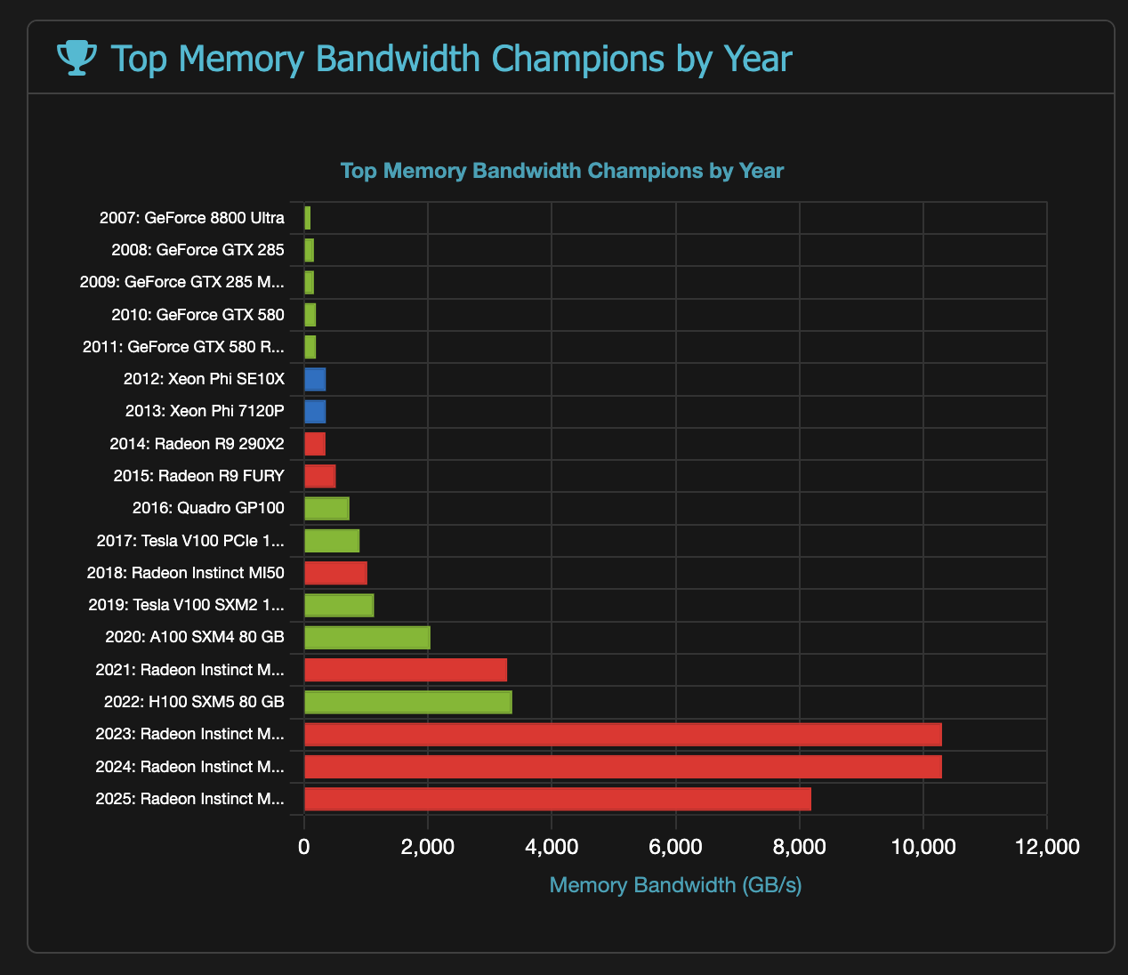
Discussion: Memory Bandwidth in GPUs?

Slide 17
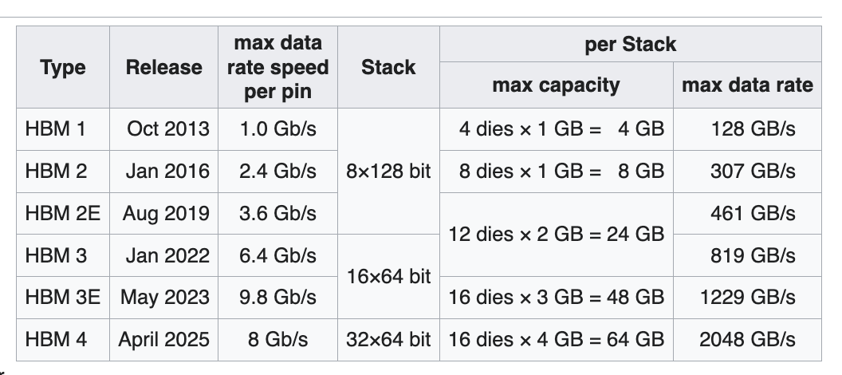
Discussion: Memory Bandwidth with HBM?

